Slide 1
Creating animated charts in R
Lucy Charlton
Using gganimate and ggplot2 to create animated charts and gifs

Slide 2
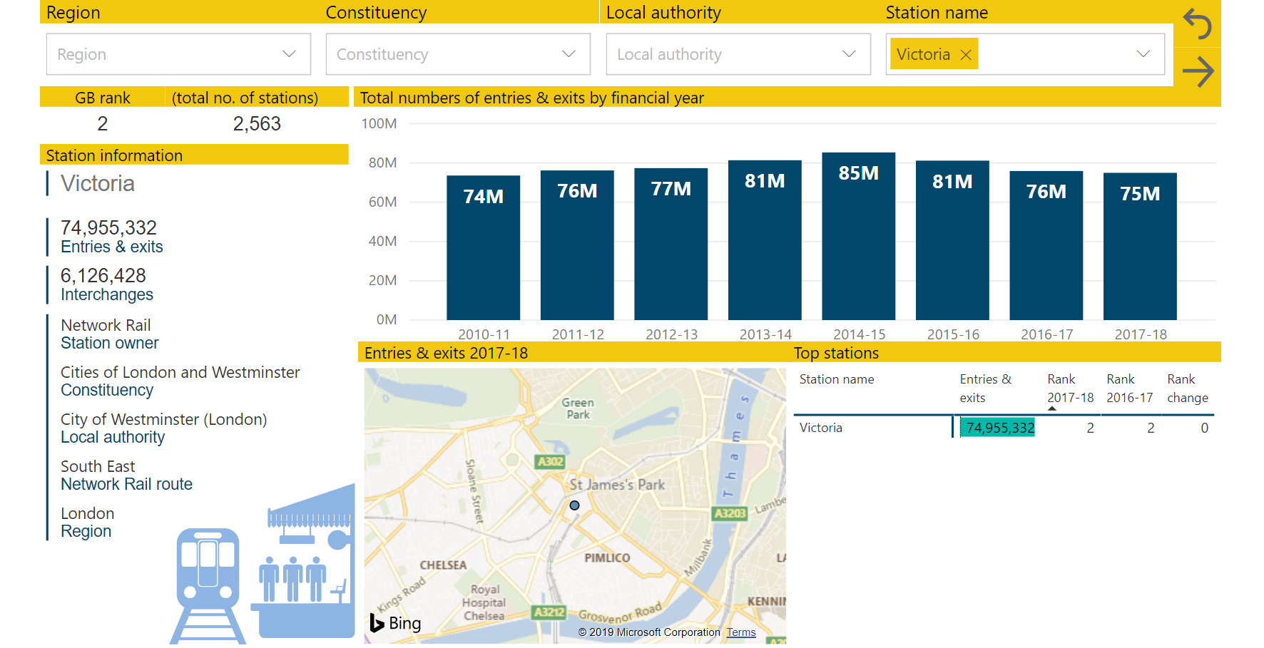
Animation- not interactive.
Power BI – can interact with data. Gifs – can’t change data

Slide 3
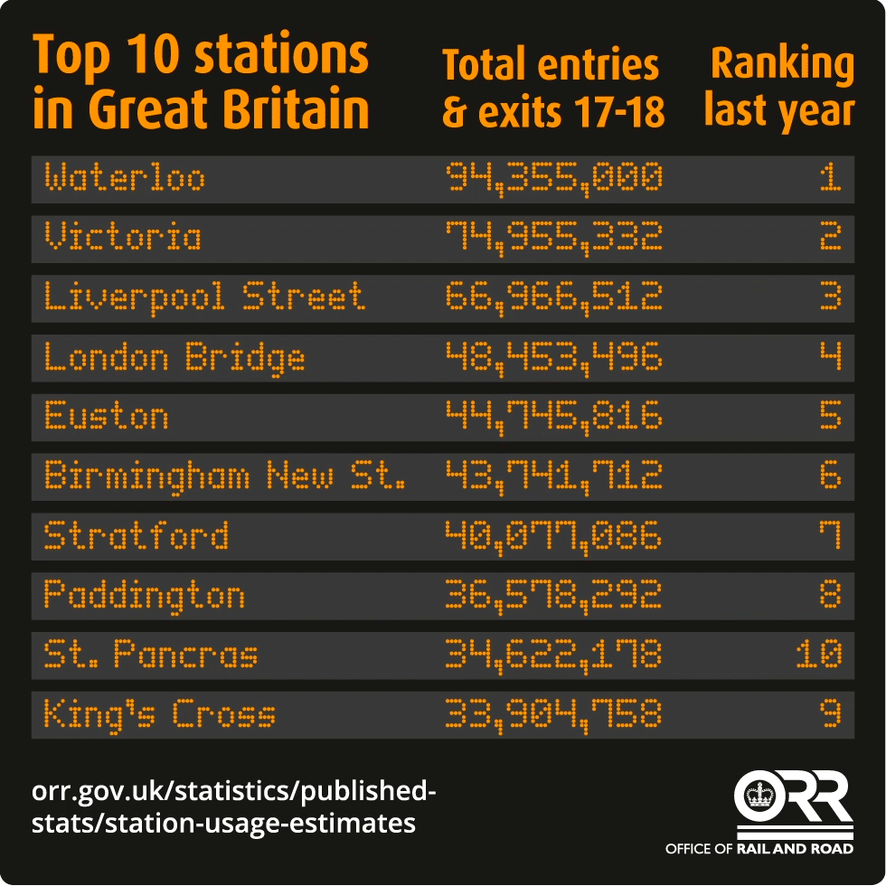
Top 10 stations- how to present changes?
A

Slide 4
Static graph showing top 10

Slide 5
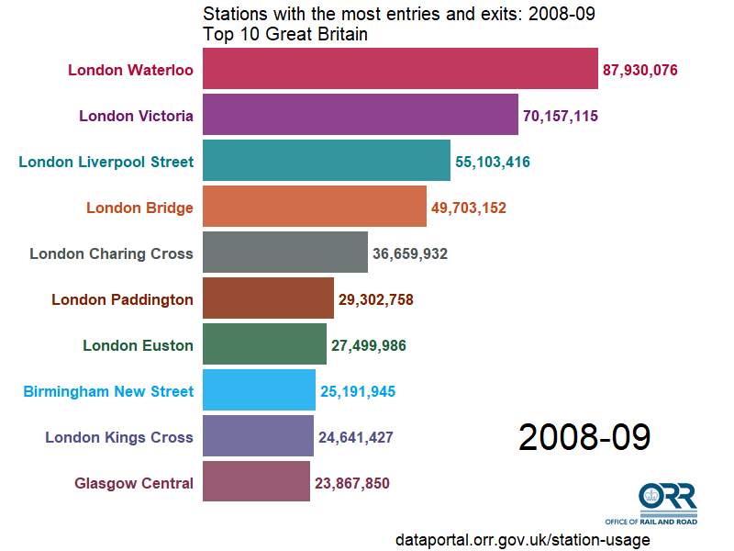
Animated version

Slide 6
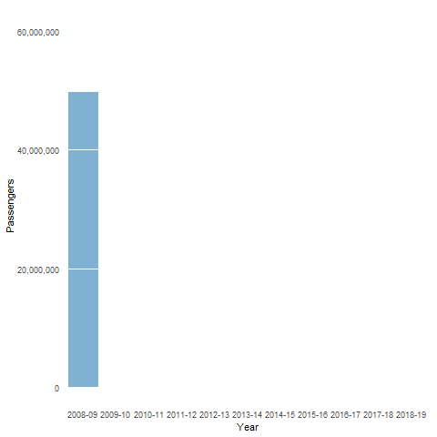
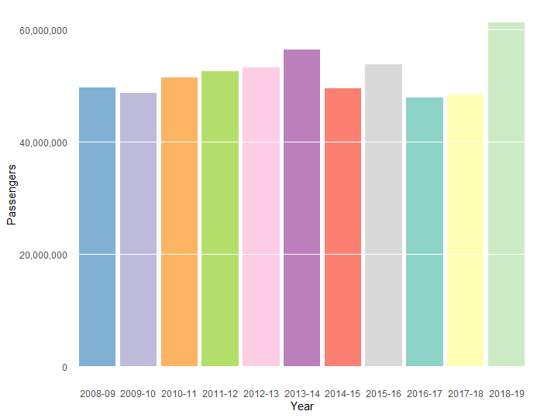
Bar chart- simple animation
Bar chart 1 in R Code
Bar chart 2 in R Code

Slide 7
Bar chart- with enter_grow and enter_fade
Bar chart 3 in R Code

Slide 8
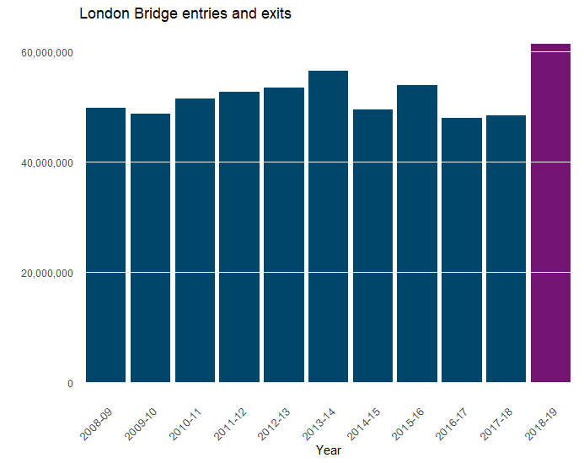
Bar chart- static
Bar chart 4 in R Code

Slide 9
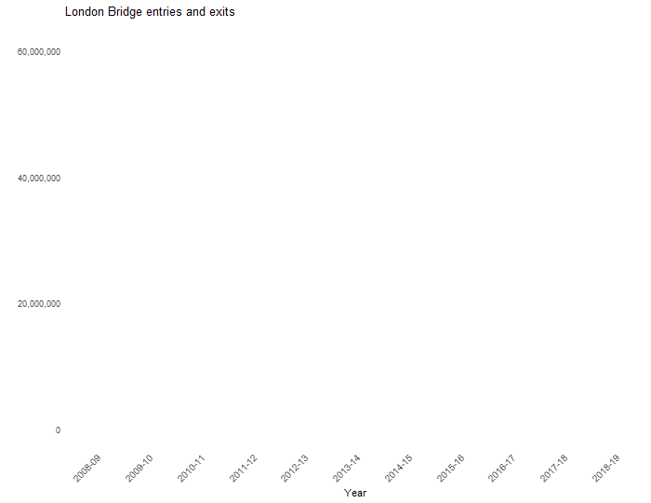
Bar chart- growing and colour change
Bar chart 5 in R Code

Slide 10
Let’s look at some code!

Slide 11
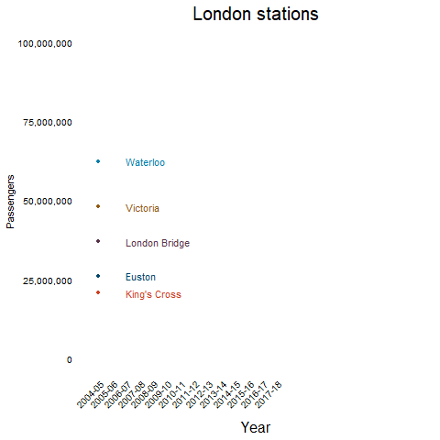
Examples-line graph showing data over time

Slide 12
How does animation work
Using ggplot and gganimate
Same as static graph, but it include transition reveal variable (usually time)
Can create ORR template so uses fonts and colours and means every graph has similar look
Using code means it is easier to produce lots of similar graphs

Slide 13
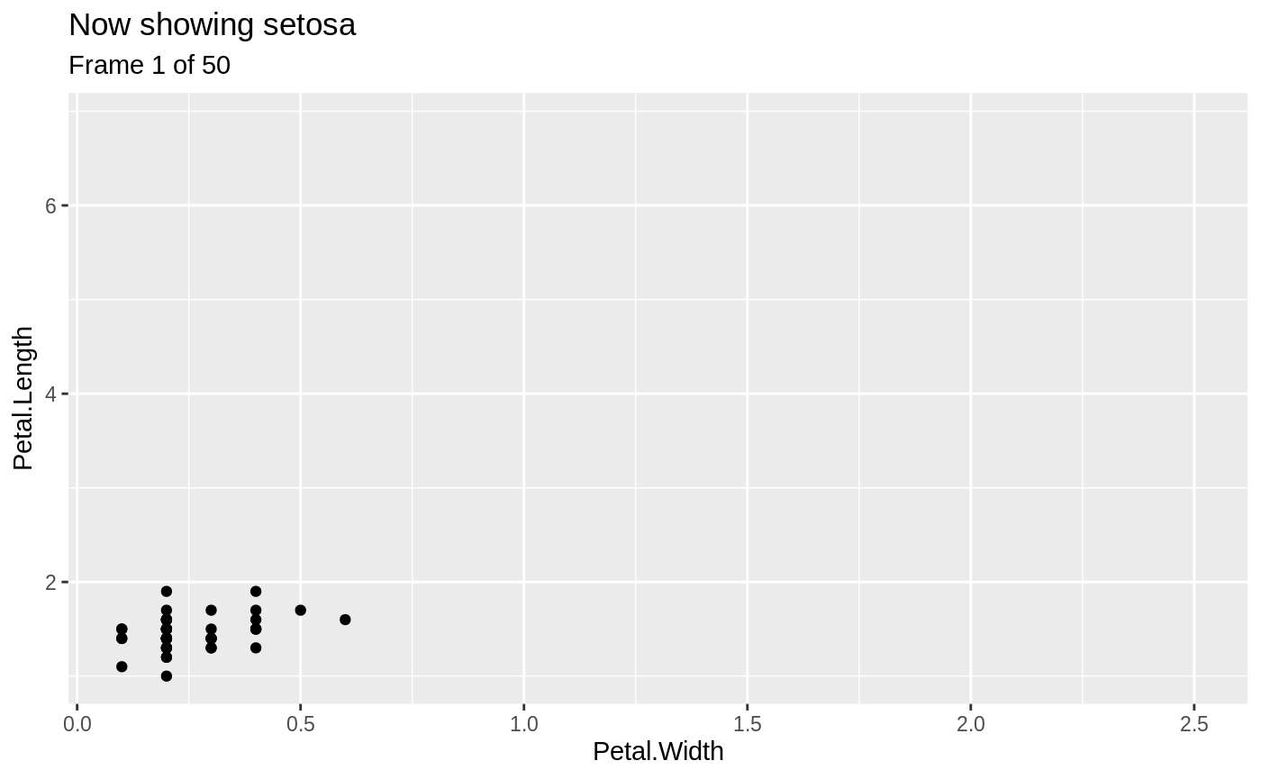
Customise your animation
transition_states() splits up plot data by a discrete variable and animates between the different states.
There will be a smooth transition between the states. How to change from one value to another- depends on easing ease_aes
Can label each frame
using glue syntax
Make data enter and exit
Set shadow for data

Slide 14
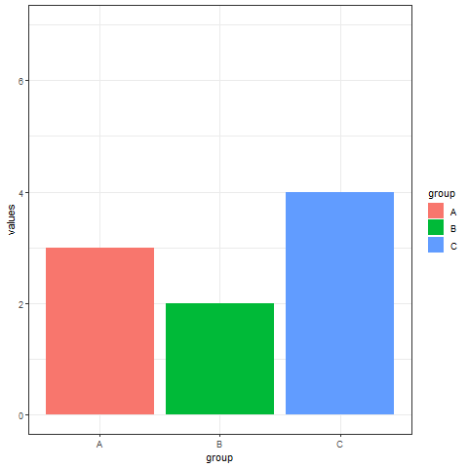
Lots of other ideas
# libraries:
library(ggplot2)
library(gganimate)
# Basic barplot:
ggplot(a, aes(x=group, y=values, fill=group)) +
geom_bar(stat='identity')
# Make a ggplot, but add frame=year: one image per year
ggplot(data, aes(x=group, y=values, fill=group)) +
geom_bar(stat='identity') +
theme_bw() +
# gganimate specific bits:
transition_states(
frame,
transition_length = 2,
state_length = 1
) +
ease_aes('sine-in-out')
# Save at gif:
anim_save("288-animated-barplot-transition.gif")
Notes:
transition_states: Transition between several distinct stages of the data
Options:
states: The unquoted name of the column holding the state levels in the data.
transition_length: The relative length of the transition. Will be recycled to match the number of states in the data
state_length: The relative length of the pause at the states. Will be recycled to match the number of states in the data

Slide 15
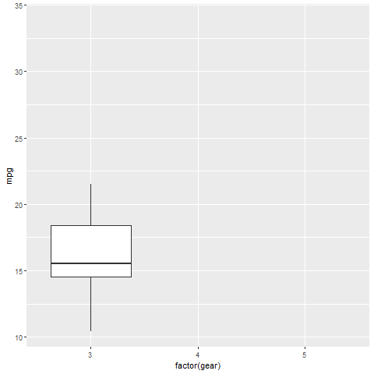
Lots of other ideas – exit fly

Slide 16
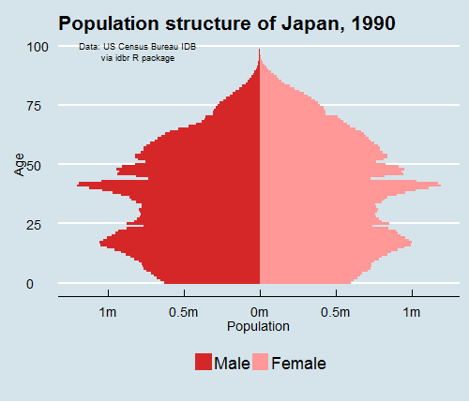
Population pyramid

Slide 17
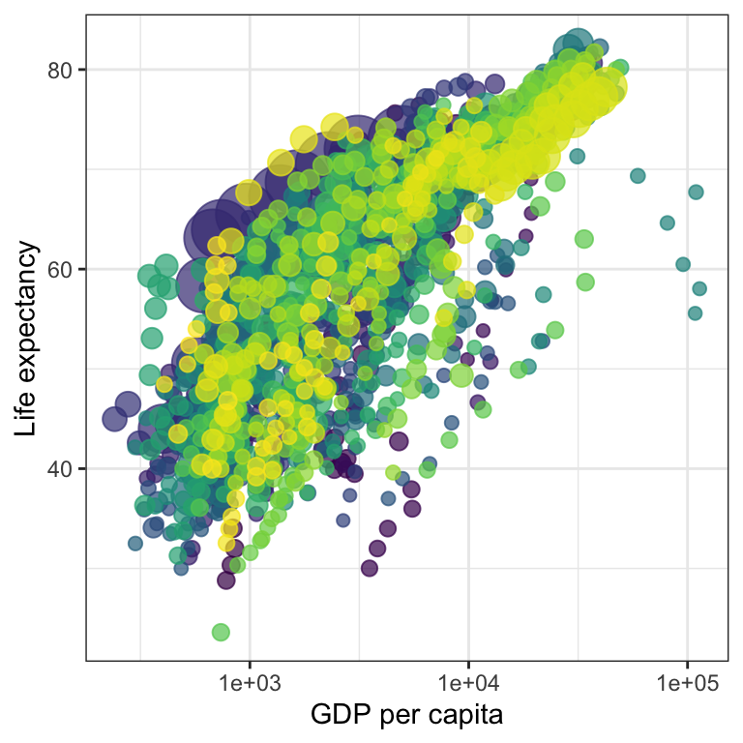
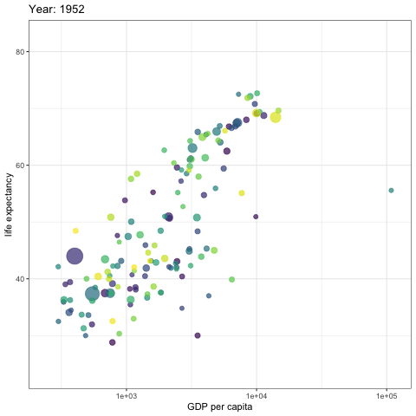
Scatterplot animation

Slide 18
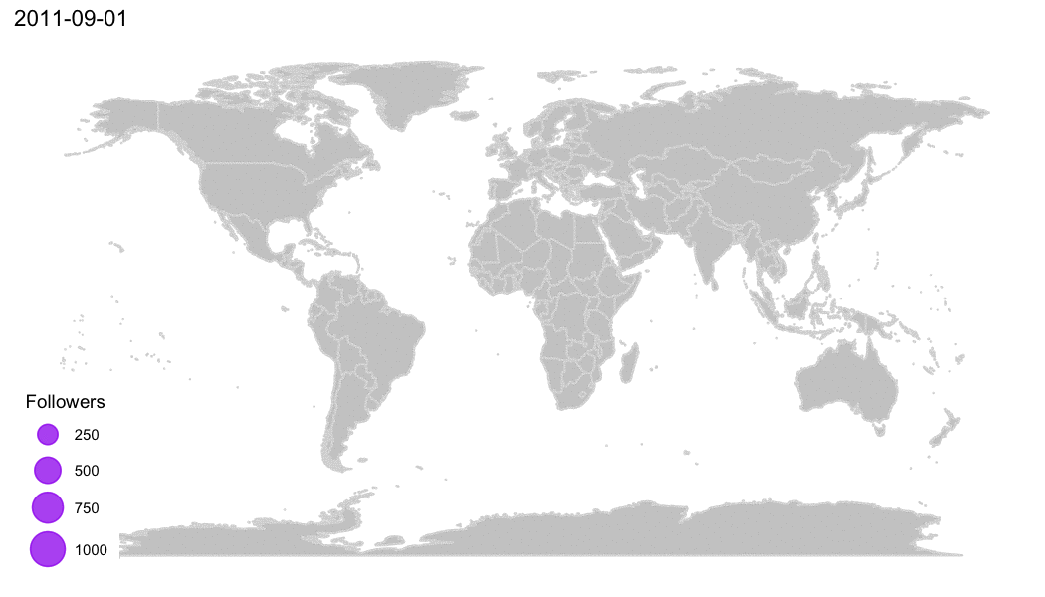
Animated maps

Slide 19
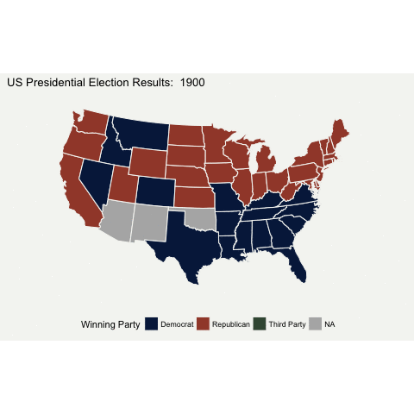
Animated maps

Slide 20
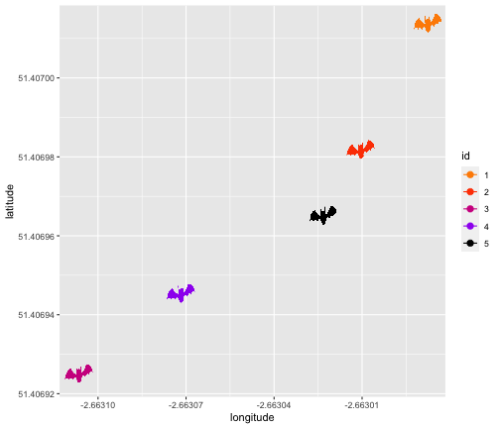
Can adjust axis with view_follow
https://goodekat.github.io/presentations/2019-isugg-gganimate-spooky/slides.html#1
Very good resource and shows different examples

Slide 21
Using gifs
Can customise appearance:
Speed and duration
Frames per second
Pausing on certain frames
Turn looping off or rewind gif or only loop for set number
Colours/text/size etc
Can always save as video mp4
anim<-animate(chart1, nframes=150, fps=5, end_pause=10, width = 800, height = 600)

Slide 22
Tips and tricks
Create a static graph first and do all your customising (themes, colours, etc) in that FIRST. Creating animations takes time and can be annoying to keep erunning again.
Leave a pause on the last frame to help it sink in anim<-animate(chart, nframes=150, fps=5, end_pause=10, width = 800, height = 600)
Use enter_fade and exit_fade to make animation smoother
With racing bar chart, remember the x and y axis are reversed!
Don’t transition data from the last stage to the first: use transition_states(wrap=FALSE)

Slide 23
Tips and tricks
Different ways to share gif (Twitter, Powerpoint, webpage, email, Word if you insert as a slide hack)
Consider making a dummy version if you want to share before pre release
Reduce duration and frames per second to speed up rendering
Not just restricted to charts, can animate maps as well
Cheat sheet https://ugoproto.github.io/ugo_r_doc/pdf/gganimate.pdf
Look online for inspiration

